Slide 1
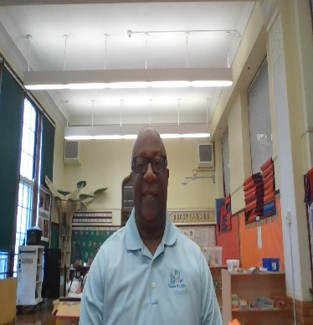
Greetings parents and students!
Welcome back! I am Mr. Davis, your child’s Physical Education teacher. I have been here at Bryan Hill for 9 years I love Physical Education and I believe it is a vital part of helping our students to develop skills that will contribute to a lifelong understanding of health and the importance of Physical Education. Your child will participate in a variety of team sports. We will also work to develop fine and loco motor movement skills.
PE Classroom Rules
Be Safe.
Wear athletic shoes on PE Days.
Follow instructions.
Have fun!
Homework policy
Homework will be assigned during the week. All assigned work should be turned in during the next PE class.
Virtual policy
Computers and/or I-pads at Bryan Hill Elementary are to be used for assigned research, word-processing, and online activities that support PE selected skills. Unauthorized use and/or vandalism of computer hardware or peripherals will result in loss of computer and/or I-pad privileges. Students are expected to follow the rules, regulations, and policies of the St. Louis Public School District.
Contact Information:
Phone Number: (314) 534 – 0370
Planning Time: 2:15—2:45 M-F
Email: Steven.Davis2@slps.org

